Slide 1

QTM 151: Introduction to Statistical Computing II
Dr. Juan Estrada

Slide 2
Agenda
Introductions
CLASS DETAILS
COMPUTING Environment

Slide 3

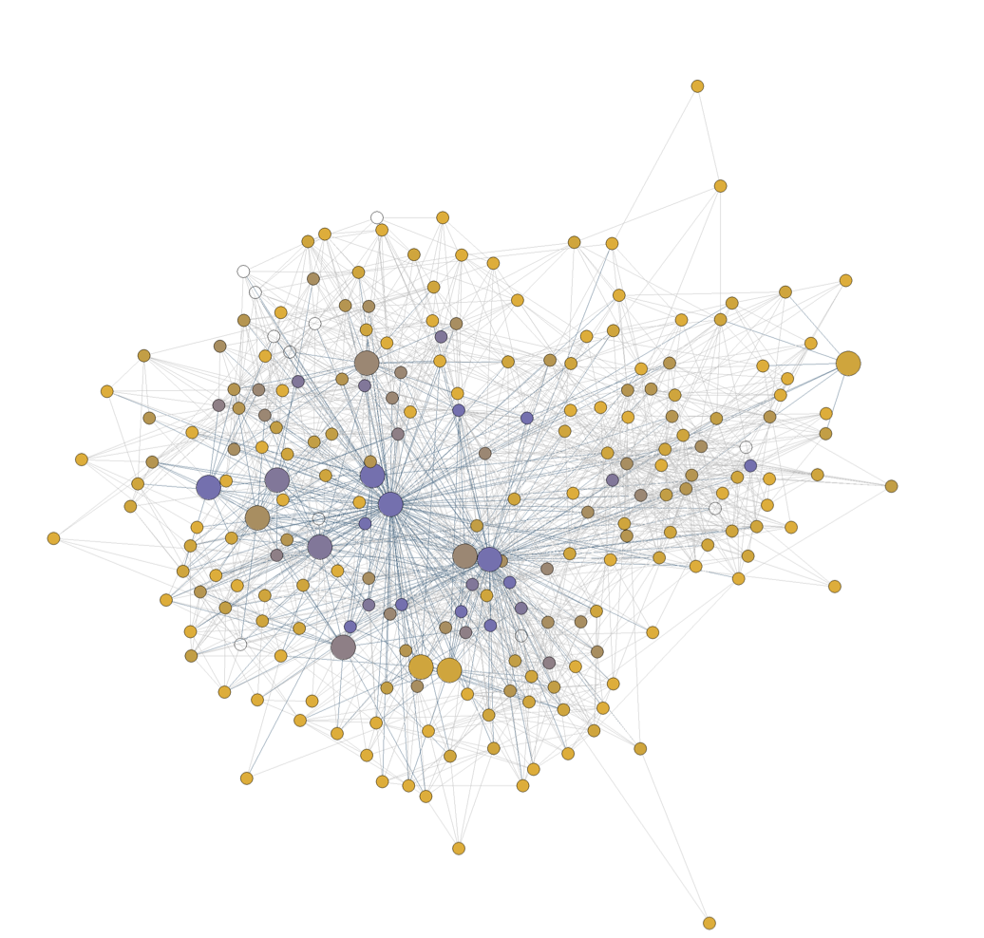
About me
My name is Juan Estrada
I finished my Ph.D. in Economics at Emory
I’m originally from Colombia.
My research focuses on causal inference and network analysis. I focus on applications related with American politics

Slide 4
Teaching Assistants
Neil Das (neil.das@emory.edu). Junior
Vincent (Tianze) Luo (tluo35@emory.edu). Senior
Jeremy (Yichi) Zhang (jeremy.zhang@emory.edu). Junior
They will be answering questions during our lectures and holding office hours (see Canvas for office hours information).

Slide 5
Questions for the class

Slide 6
Agenda
Introductions
CLASS DETAILS
COMPUTING Environment

Slide 7




Our class in a nutshell …
Virtual Environment
+
Python
Interactive Development Environment (IDE)
Environment where the user writes the scripts
Script File
File with code in the Python programming language.
Instructions for the program to follow
(in background)
Programming language we use to write the instructions

Slide 8
Installing Python using Anaconda
Follow the instructions Installing Python Using Anaconda from Canvas
We are using Anaconda virtual environments for this class (I will cover this in more detail next class)
For now: Anaconda comes with a Python installation
Questions?

Slide 9
Installing VS code and connecting Anaconda
Follow the instructions Installing Visual Studio Code and Connecting it with Anaconda from Canvas
For now: know that “base” is the default Anaconda virtual environment that comes with the installation
The next step is to check if the connection between VS code and Anaconda worked.
Before: we are creating a new folder for the QTM151 course and downloading our virtual GitHub folder

Slide 10
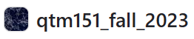



Lecture Notes
Interactive Development Environment (IDE)
+
Python
Github:
A file management system in the cloud (with desktop app)
Has version control
Great for collaborative programming

Slide 11
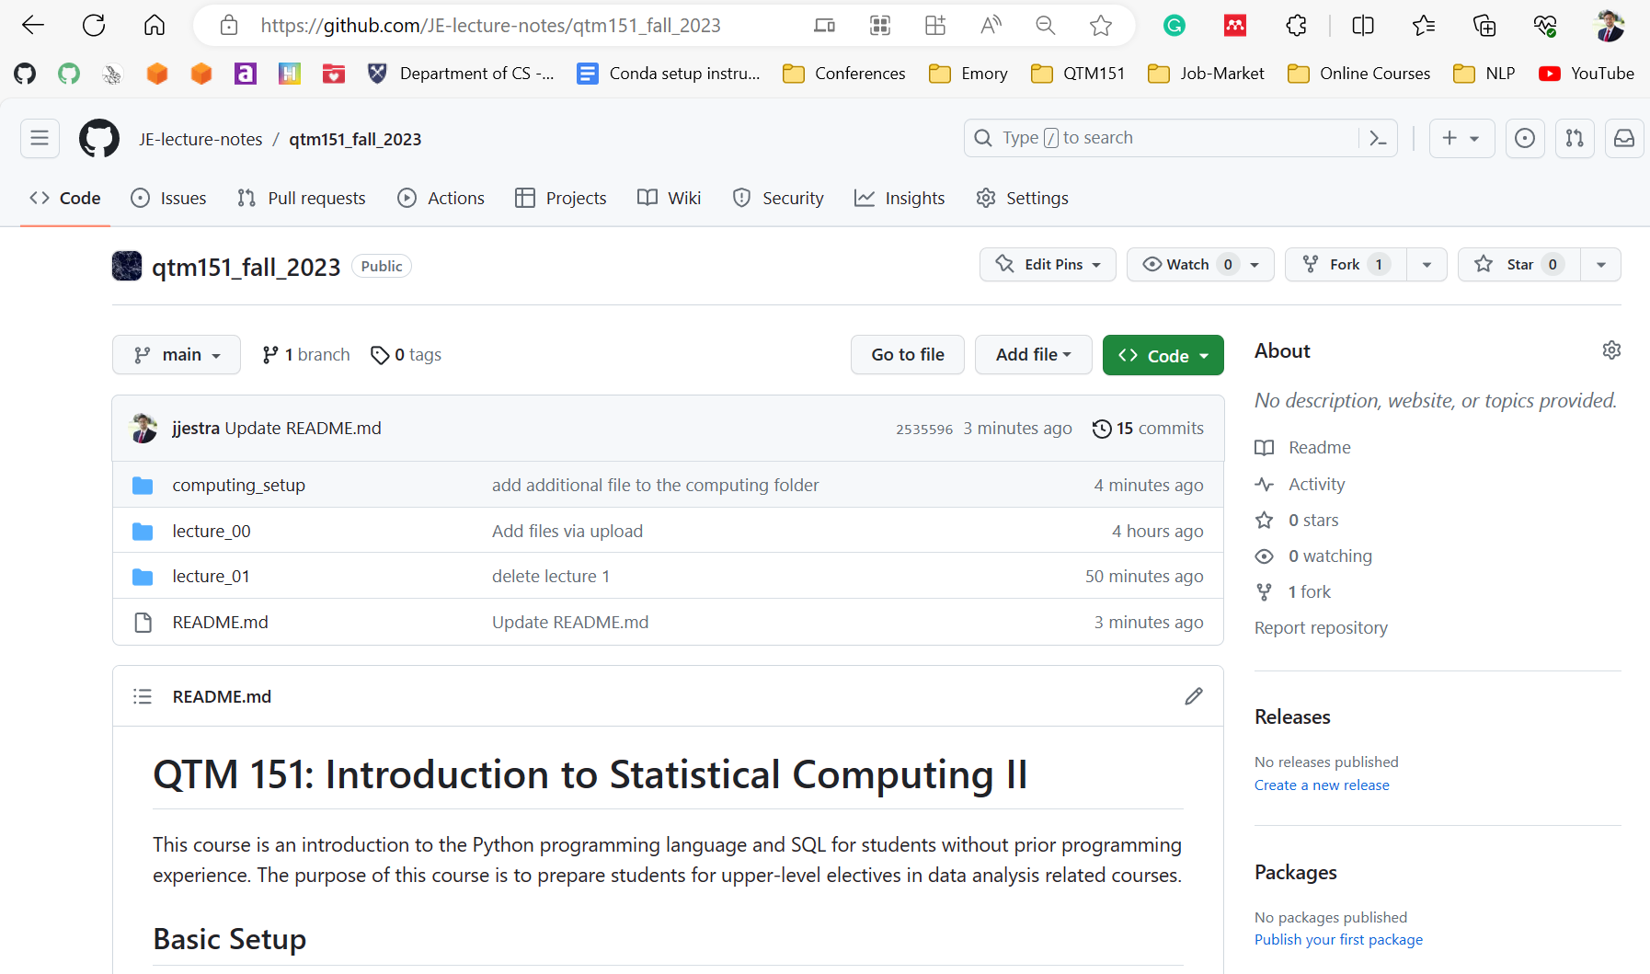
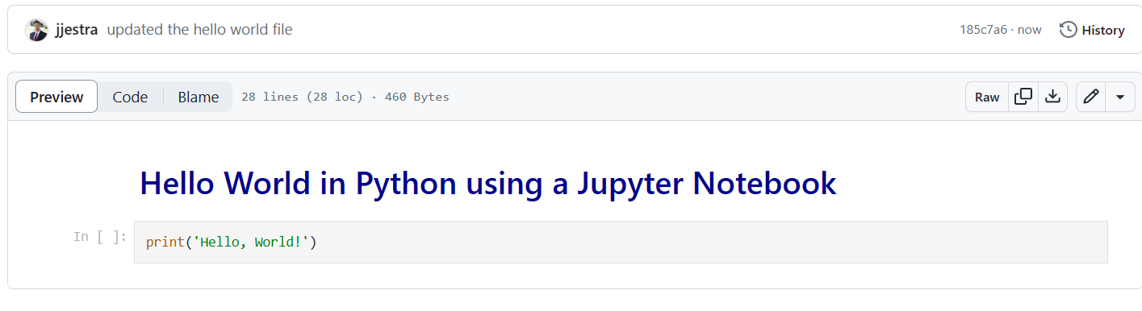
Lecture notes are publicly available at my GitHub website:
JE-lecture-notes/qtm151_fall_2023 (github.com)
You can view the lectures in the browser

Slide 12
Downloading the lecture notes locally
Follow the instructions Github1 Getting Started from Canvas
Focusing on Step 2: Downloading Lectures to your Computer
Check that we have access to the folder with the lecture notes and open it in VS code → Check that VS code is connected to Anaconda

Slide 13
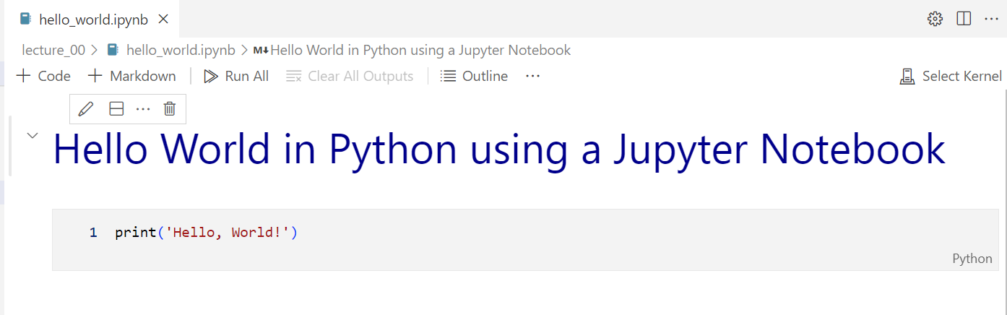
A Jupyter Notebook (“.ipynb”) is a file with code and annotations
All the lecture notes are written as Jupyter notebooks
It is encouraged that you bring your laptop to class
Lecture notes are designed to be follow-along. There will be “try it yourself” exercises.

Slide 14

Interactive Development Environment (IDE)
+
Python
See Assignment 1 (due Tuesday, August 29 at 10 p.m.):
Basics of a Jupyter notebook
Need to have all the tools installed
Install soon that we can help you with any issues!

Slide 15
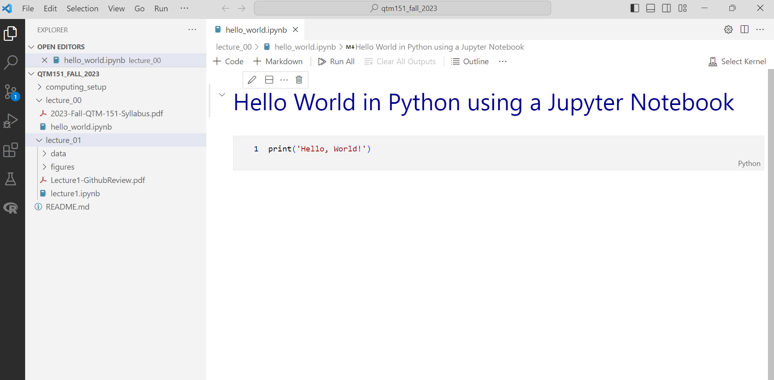
We will do all our coding in Visual Studio Code
Python
“.ipynb”: Interactive Python Notebook
Lecture notes

Slide 16
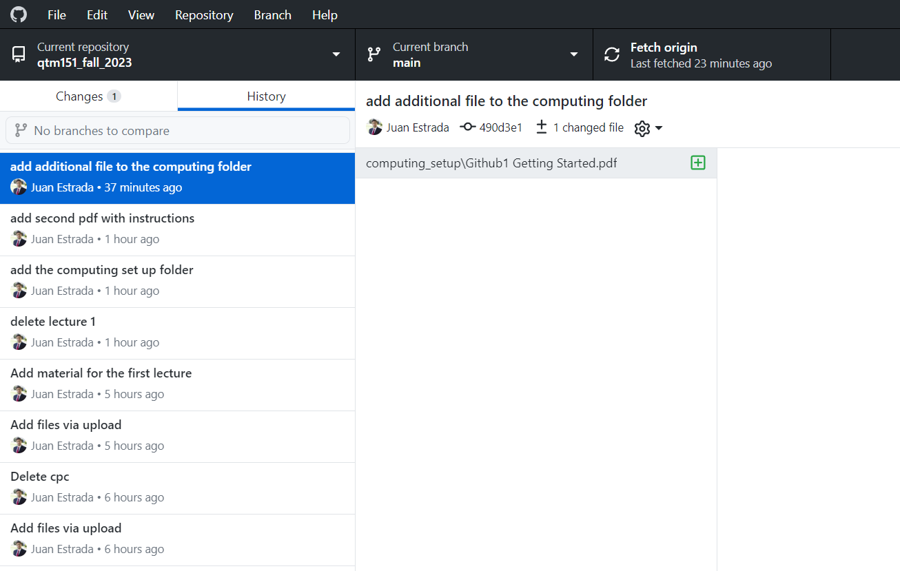
Github Desktop will allow you to automatically download the lectures notes from my account (and update them).
It will also show you
the date of any update
what the changes are

Slide 17
Agenda
Introductions
CLASS DETAILS
COMPUTING Environment

Slide 18
Learning Objectives
Learn how to code effectively in Python and SQL
Learn about key programming principles
Learn how to manipulate and visualize data

Slide 19
Grades
Late submissions
Late assignments will not receive points
To account for unforeseen circumstances, we will drop the worst assignment and the worst quiz
Watch out for the assignments to install software (1, 10). You will need these to be able to use the lectures notes.
Assignments (x 10): 50%
Practice class concepts
Quizzes (x5): 30%
Questions are given in advance
Data is provided in the class
Final Project: 20 %
Will provide guidelines on Canvas
Due at the end of the semester (April 25, 2023)
Midsemester Survey: + 0.5% (Extra)

Slide 20
Coding ability is not innate
Coding ability can be developed.
Academic skills and abilities are acquired through hard work, mistakes, and perseverance.
My only goal here is that you learn the material. Please ask me questions!

Slide 21
Questions about the logistics

